Slide 2
Learning Objectives (1 of 2)
Describe major applications of a data communication system
Explain the major components of a data communication system
Describe the major types of processing configurations
Explain the three types of networks
Describe the main network topologies

Slide 3
Learning Objectives (2 of 2)
Explain important networking concepts, such as bandwidth, routing, routers, and the client/server model
Describe wireless and mobile technologies and networks
Discuss the importance of wireless security and the techniques used
Summarize the convergence phenomenon and its applications for business and personal use

Slide 4
Data Communication
Electronic transfer of data from one location to another
Enables an information system to deliver information
Improves the flexibility of data collection and transmission
Basis of virtual organizations
Provides e-collaboration

Slide 5
Why Managers Need to Know about Data Communication (1 of 3)
Enhances decision makers’ efficiency and effectiveness
Enables organizations to use e-mail and electronic file transfer to improve efficiency and productivity

Slide 6
Why Managers Need to Know about Data Communication (2 of 3)
Effects of data communication technologies
Online training for employees can be provided via virtual classrooms
Internet searches for information keep employees up to date
The Internet and data communication systems facilitate lifelong learning

Slide 7
Why Managers Need to Know about Data Communication (3 of 3)
Boundaries between work and personal life are less clear-cut as data communication is more available in both homes and businesses
Web and video conferencing are easier

Slide 8
Basic Concepts of a Data Communication System (1 of 2)
Bandwidth
Amount of data that can be transferred from one point to another in a certain time period
Attenuation
Loss of power in a signal as it travels from the sending device to the receiving device
Broadband
Multiple pieces of data are sent simultaneously to increase the transmission rate

Slide 9
Basic Concepts of a Data Communication System (2 of 2)
Narrowband
Voice-grade transmission channel capable of transmitting a maximum of 56,000 bps, so only a limited amount of information can be transferred
Protocols
Rules that govern data communication
Error detection, message length, and transmission speed

Slide 10
Sender and Receiver Devices (1 of 4)
Input/output device, or thin client
Used only for sending or receiving information
No processing power
Smart terminal
Performs certain processing tasks but is not a full-featured computer

Slide 11
Sender and Receiver Devices (2 of 4)
Intelligent terminal, workstation, or personal computer
Performs certain processing tasks without the main computer’s support
Netbook computer
Low-cost, diskless computer used to connect to the Internet or a LAN
Runs software off servers and saves data to servers

Slide 12
Sender and Receiver Devices (3 of 4)
Minicomputers, mainframes, and supercomputers
Process data and send it to other devices
Receive data that has been processed elsewhere, process it, and then transmit it to other devices
Smartphones mobile phones, MP3 players, and PDAs
Advanced capabilities, with a built-in keyboard or an external USB keyboard

Slide 13
Sender and Receiver Devices (4 of 4)
Video game console
Receives instructions from a game player and produces a video display signal on a television screen or monitor

Slide 14
Modems (1 of 2)
Devices that connect a user to the Internet
Short for modulator-demodulator
Not required for all Internet connections

Slide 15
Modems (2 of 2)
Dial-up
Analog modem is necessary to convert a computer’s digital signals to analog signals
Digital subscriber line (DSL)
High-speed service that uses ordinary phone lines
Cable modems
Use the same cable that connects to TVs for Internet connections

Slide 16
Communication Media
Connect sender and receiver devices
Can be conducted (wired or guided) or radiated (wireless)
Can be a point-to-point or a multipoint system

Slide 17
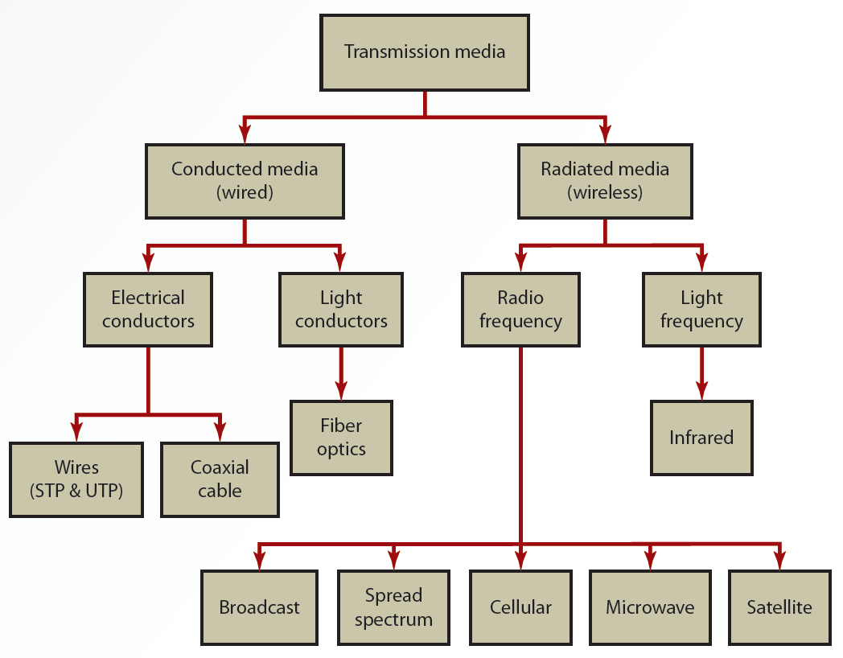
6.1 Types of Communication Media

Slide 18
Processing Configurations
Data communication systems can be used in several different configurations
Depending on users’ needs, types of applications, and responsiveness of the system
During the past 60 years, three types of process configurations have emerged
Centralized, decentralized, and distributed

Slide 19
Centralized Processing (1 of 2)
Processing is done at one central computer
Used in early days of computer technology
Data-processing personnel were in short supply
Hardware and software were expensive

Slide 20
Centralized Processing (2 of 2)
Advantage
Ability to exercise tight control on system operations and applications
Disadvantage
Lack of responsiveness to users’ needs

Slide 21
Decentralized Processing
Each user, department, or division has its own computer for performing processing tasks
Advantage
Responsive to users
Disadvantages
Lack of coordination among organizational units
High cost of having many systems
Duplication of efforts

Slide 22
Distributed Processing (1 of 2)
Maintains centralized control and decentralized operations
Some advantages
Accessing unused processing power
Computer power can be added or removed
Distance and location are not limiting
More compatible with growth
Fault tolerance is improved
Resources can be shared to reduce costs

Slide 23
Distributed Processing (2 of 2)
Disadvantages
More security and privacy challenges
Incompatibility between various pieces of equipment
Managing the network is challenging

Slide 24
Open Systems Interconnection Model (1 of 2)
Seven-layer architecture for defining how data is transmitted from computer to computer in a network
Standardizes interactions between network computers exchanging information
Layers in the architecture
Application: serves as the window through which applications access network services
Presentation: formats message packets

Slide 25
Open Systems Interconnection Model (2 of 2)
Session: establishes a communication session between computers
Transport: generates the receiver’s address and ensures the integrity of messages
Network: routes messages
Data link: oversees the establishment and control of the communication link
Physical: defines the physical medium used for communication

Slide 26
Types of Networks (1 of 2)
Network Interface Card (NIC)
Hardware component that enables computers to communicate over a network
Known as an adapter card
Operates at the OSI model’s Physical and Data Link

Slide 27
Types of Networks (2 of 2)
Local area network (LAN)
Connects workstations and peripheral devices that are in close proximity
Wide area network (WAN)
Spans several cities, states, or countries and is owned by different parties
Metropolitan area network (MAN)
Designed to handle data communication for multiple organizations in a city and nearby cities as well

Slide 28
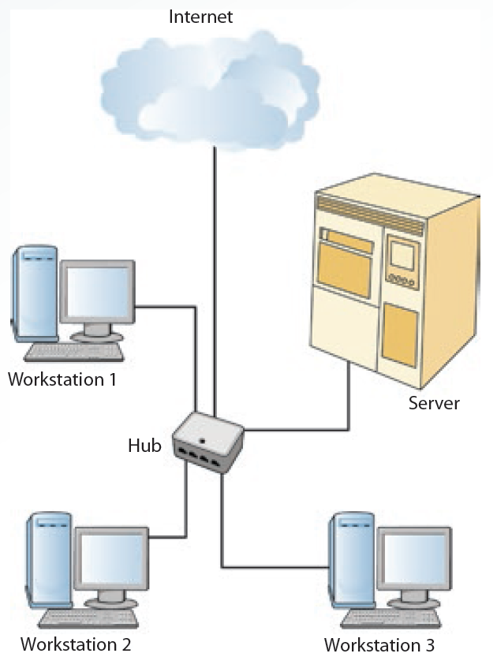
6.3 A Local Area Network

Slide 29
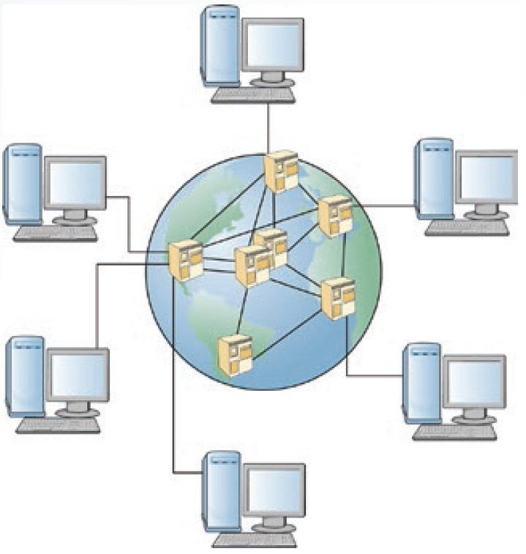
6.4 A Wide Area Network

Slide 30
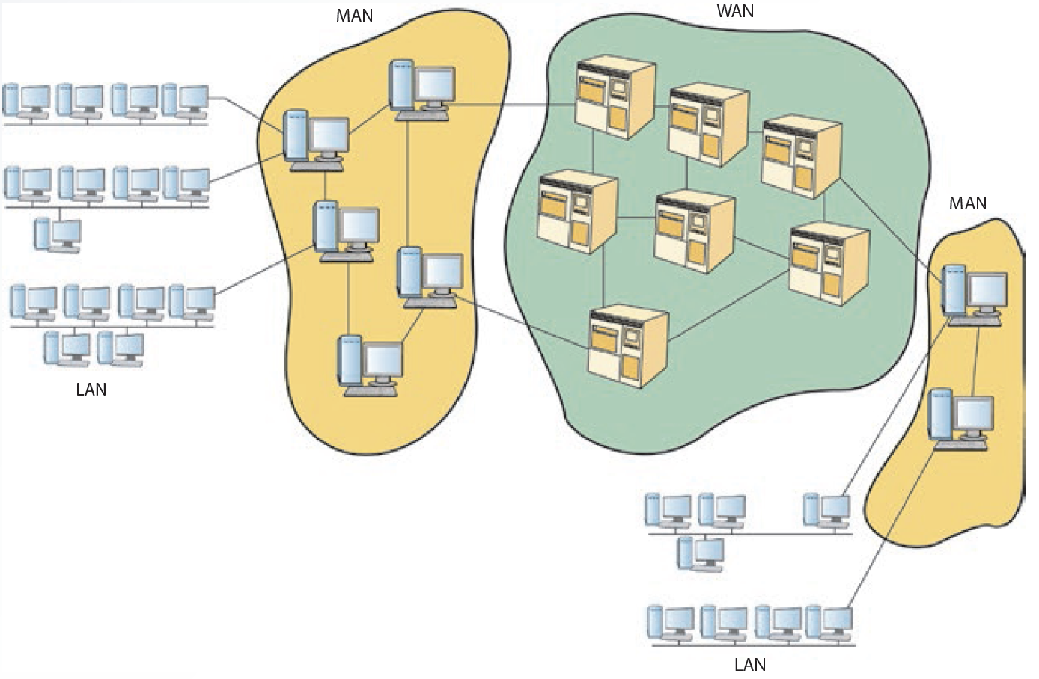
6.5 A Metropolitan Area Network

Slide 31
Network Topologies
Represent a network’s physical layout, including the arrangement of computers and cables
Common topologies
Star
Ring
Bus
Hierarchical
Mesh

Slide 32
Star Topology (1 of 2)
Consists of a central computer and a series of nodes
Advantages
Cable layouts are easy to modify
Centralized control makes detecting problems easier
Nodes can be added to the network easily
Effective at handling short bursts of traffic

Slide 33
Star Topology (2 of 2)
Disadvantages
If the central host fails, the entire network becomes inoperable
Increases cost as many cables are required

Slide 34
Ring Topology
No host computer is required; each computer manages its own connectivity
Each node is connected to two other nodes: upstream and downstream neighbors
Transmission is in one direction
Needs less cable than star topology
Diagnosing problems and modifying the network are difficult

Slide 35
Bus Topology (1 of 2)
Connects nodes along a network segment
Ends of the cable are not connected
Terminator: hardware device used at each end of the cable to absorb the signal

Slide 36
Bus Topology (2 of 2)
Advantages
Easy to extend and reliable
Wiring layout is simple and uses the least amount of cable of any topology; keeps costs down
Best for handling steady traffic
Disadvantages
Fault diagnosis is difficult
Bus cable can be a bottleneck when network traffic is heavy

Slide 37
Hierarchical Topology (1 of 3)
Combines computers with different processing strengths in different organizational levels
Used by traditional mainframe networks
Mainframe computer is at the top
Front-end processors (FEPs) are at the second level

Slide 38
Hierarchical Topology (2 of 3)
Controllers and multiplexers are at the third level
Controller: hardware and software device that controls data transfer from a computer to a peripheral device
Multiplexer: hardware device that allows several nodes to share one communication channel
Terminals and workstations are at the bottom level

Slide 39
Hierarchical Topology (3 of 3)
Advantage
Offers a greater deal of network control and lower cost than star topology
Disadvantages
Network expansion may pose a problem
Traffic congestion at the root and higher-level nodes

Slide 40
Mesh Topology
Every node is connected to every other node
Known as plex or interconnected
Advantage
Highly reliable
Disadvantage
Expensive and difficult to maintain and expand

Slide 41
Major Networking Concepts
Important networking concepts
Protocols
TCP/IP
Routing
Routers
Client/server model

Slide 42
Protocols
Agreed-on methods and rules that electronic devices use to exchange information
Deal with hardware connections, control data transmission, and file transfers
Specify the format of message packets sent between computers

Slide 43
Transmission Control Protocol/Internet Protocol (1 of 2)
Industry-standard suite of communication protocols that enables interoperability
Allows the linking of devices running on many different platforms
Transmission Control Protocol (TCP)
Operates at the OSI model’s Transport layer
Establishes a link between hosts
Ensures message integrity and sequences and acknowledges packet delivery
Regulates data flow

Slide 44
Transmission Control Protocol/Internet Protocol (2 of 2)
Internet Protocol (IP): operates at the OSI model’s Network layer
Responsible for packet forwarding
Divided into network address and node address

Slide 45
Routing (1 of 2)
Packet
Collection of binary digits sent from computer to computer over a network
Includes message data and control characters for formatting and transmitting
Routing
Process of deciding which path data takes
Determined by the type of network and the software used to transmit data

Slide 46
Routing (2 of 2)
Routing table: generated automatically by software
Determines the best possible route for a packet
Decision about selecting a route to follow on a network
Centralized routing: one node is in charge of selecting the path for all packets
Distributed routing: relies on each node to calculate its own best possible route

Slide 47
Routers (1 of 2)
Network connection device containing software that connects network systems and controls their traffic flow
Choose the best path for packets based on distance or cost
Prevent network jams that delay packet delivery
Handle packets of different sizes

Slide 48
Routers (2 of 2)
Static router
Requires the network routing manager to give it information about which addresses are on which network
Dynamic router
Can build tables that identify addresses on each network
Used more often now, particularly on the Internet

Slide 49
Client/Server Model (1 of 2)
Software runs on the local computer and communicates with the remote server to request information or services
Server: remote computer on the network that provides information or services in response to client requests
Advantage: scalability (i.e., ability to grow)

Slide 50
Client/Server Model (2 of 2)
Levels of logic
Presentation: how data is returned to the client
Application: software processing requests for users
Data management: data management and storage operations

Slide 51
Two-Tier Architecture
Client communicates directly with the server
Effective in small workgroups
Advantages
Application development speed, simplicity, and power
Drawback
Changes in application logic require modifications of clients, resulting in upgrade and modification costs

Slide 52
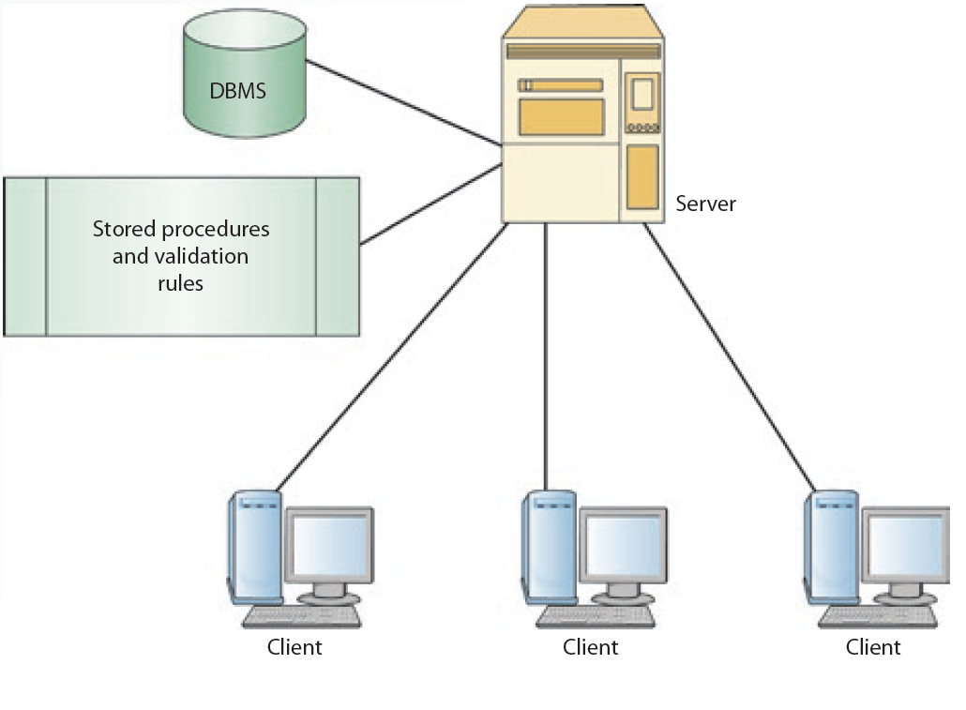
6.7 A Two-Tier Client/Server Architecture

Slide 53
N-Tier Architectures
Attempt to balance the workload between client and server
Remove application processing from client and server and place it on a middle-tier
Example: three-tier architecture
Advantage
Improved network performance
Drawbacks
Consist of more network traffic
Testing software is difficult

Slide 54
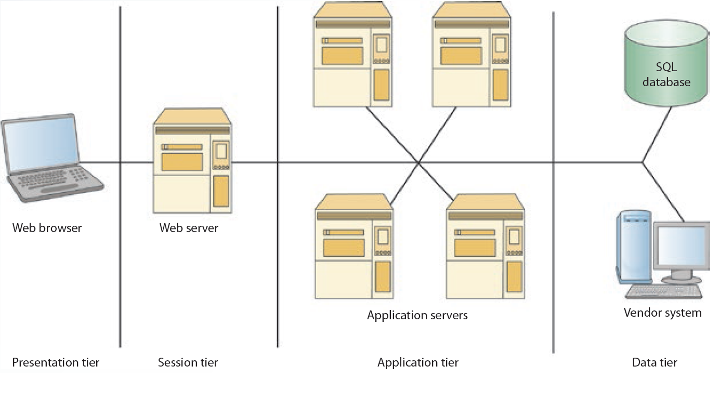
6.8 An N-Tier Architecture

Slide 55
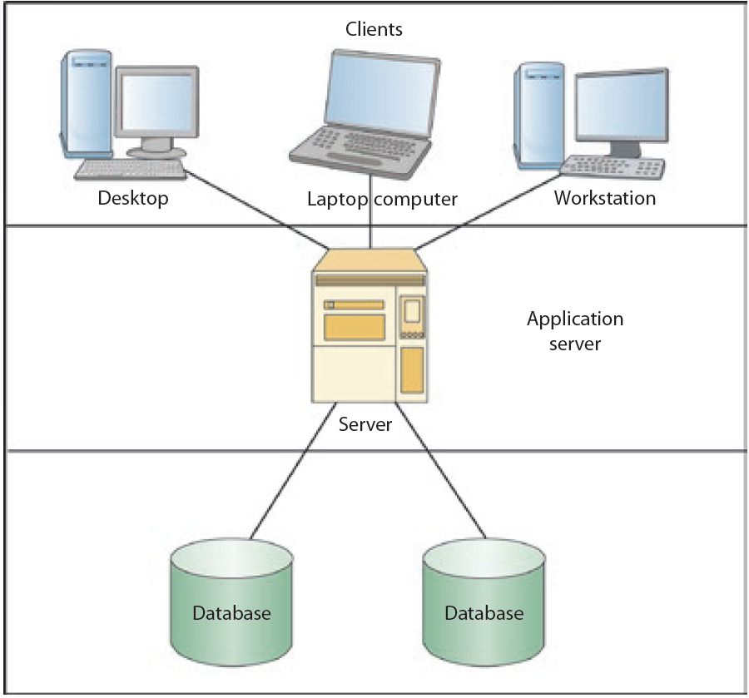
6.9 A Three-Tier Architecture

Slide 56
Wireless and Mobile Networks (1 of 2)
Wireless network
Uses wireless instead of wired technology
Mobile network
Network operating on a radio frequency (RF)
Consists of radio cells, each served by a fixed transmitter, known as a cell site or base station

Slide 57
Wireless and Mobile Networks (2 of 2)
Advantages
Mobility, flexibility, and ease of installation
Low cost
Disadvantages
Limited throughput and range
In-building penetration problems
Vulnerability to frequency noise
Security

Slide 58
Wireless Technologies
Wireless LANs
Alternative to wired LANs
Characterized by having one owner and covering a limited area
Wireless WANs
Cover a broader area than WLANs

Slide 59
Mobile Networks (1 of 2)
Consist of a three-part architecture
Base stations
Mobile telephone switching offices (MTSOs)
Subscribers
Technologies developed to improve efficiency and quality
Time Division Multiple Access (TDMA)
Increases efficiency by 300 percent; allows carrying three calls on one channel

Slide 60
Mobile Networks (2 of 2)
Code Division Multiple Access (CDMA)
Transmits multiple encoded messages over a wide frequency and then decodes them at the receiving end

Slide 61
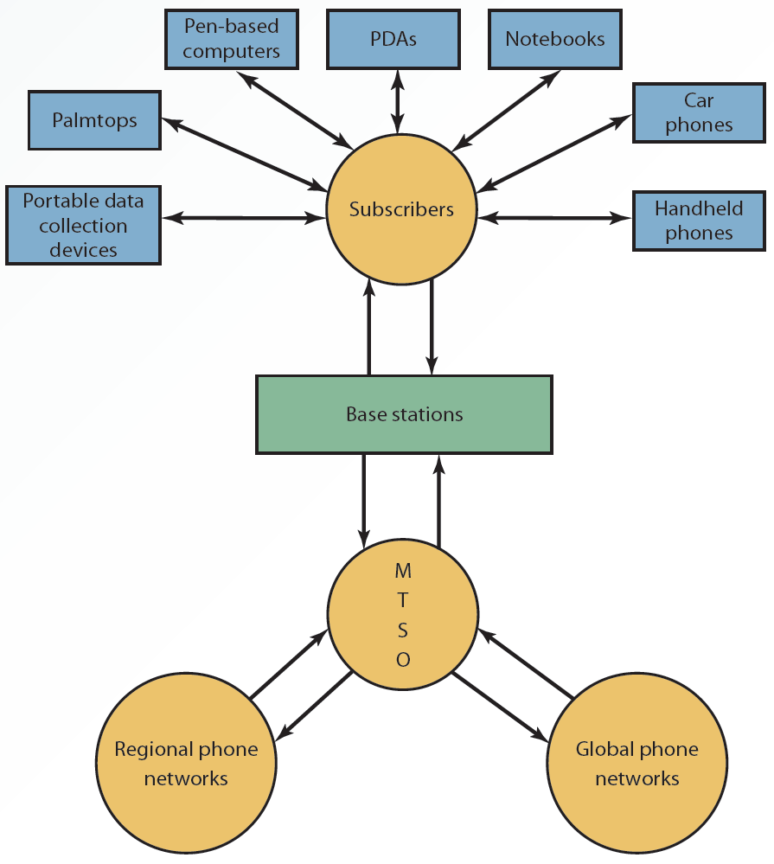
6.11 Mobile Network Architecture

Slide 62
Wireless Security
Techniques for improving security
SSID (Service Set Identifier)
WEP (Wired Equivalent Privacy)
EAP (Extensible Authentication Protocol)
WPA (Wi-Fi Protected Access)
WPA2 or 802.11i

Slide 63
Convergence of Voice, Video, and Data (1 of 2)
Convergence
Integrating voice, video, and data so that multimedia information can be used for decision making
Possible because of a combination of:
Technological innovation
Changes in market structure
Regulatory reform

Slide 64
Convergence of Voice, Video, and Data (2 of 2)
Applications of convergence
E-commerce
Increased availability of entertainment options
Increased availability and affordability of video and computer conferencing
Consumer products and services

Slide 65
Summary (1 of 2)
Data communication systems improve the flexibility of data collection and transmission
Communication media, or channels, connect sender and receiver devices
OSI standardizes interactions between network computers exchanging information

Slide 66
Summary (2 of 2)
The three major types of networks are local area networks, wide area networks, and metropolitan area networks
Network topology represents a network’s physical layout
Wireless and mobile networks have the advantages of mobility, flexibility, ease of installation, and low cost

